Slide 1


Chapter 9: Clinical Implications - IUS for Excellence in IBD Management
v1.0, 10 December 2022 | EM-121011
For Healthcare Professionals only
Developed under the mentorship of the Asian Organization for Crohn's & Colitis
Supported by Janssen Asia Pacific, a division of Johnson and Johnson International (Singapore) Pte. Ltd. Editorial development by Transform Medical Communications, New Zealand
© Janssen Asia Pacific, a division of Johnson & Johnson International (Singapore) Pte. Ltd.

Slide 2
About IUS Primer module
IUS Primer module was created for training gastroenterologists in Asia on adopting Intestinal Ultrasound (IUS) for the diagnosis and management of Inflammatory Bowel Disease
Transform Medical Communications was commissioned by Janssen Asia Pacific for the development of this educational module under the guidance of IUS Primer working group members and AOCC. The division of Janssen responsible for developing the module is from medical education that follows strict non-promotional and educational guidance.
The development of the module was funded by Janssen Asia Pacific, a division of Johnson and Johnson International (Singapore) Pte. Ltd. in 2022. Non-commercial use of this module is permitted without any further permission, provided credit for the content is clearly attributed to Janssen Asia Pacific.
AOCC: Asian Organization for Crohn's & Colitis; IUS: Intestinal ultrasound.

Slide 3
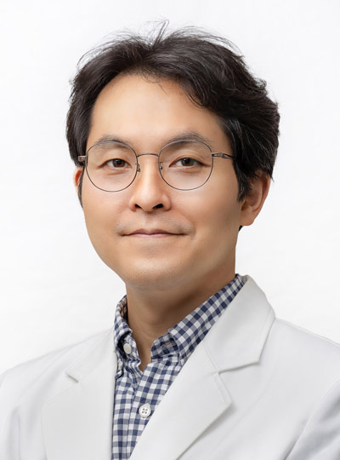
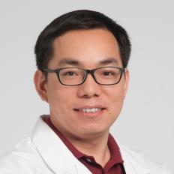
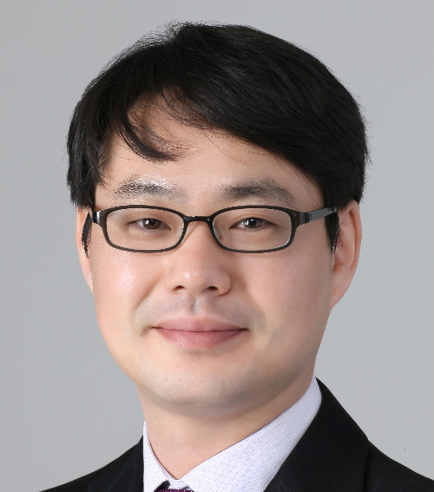

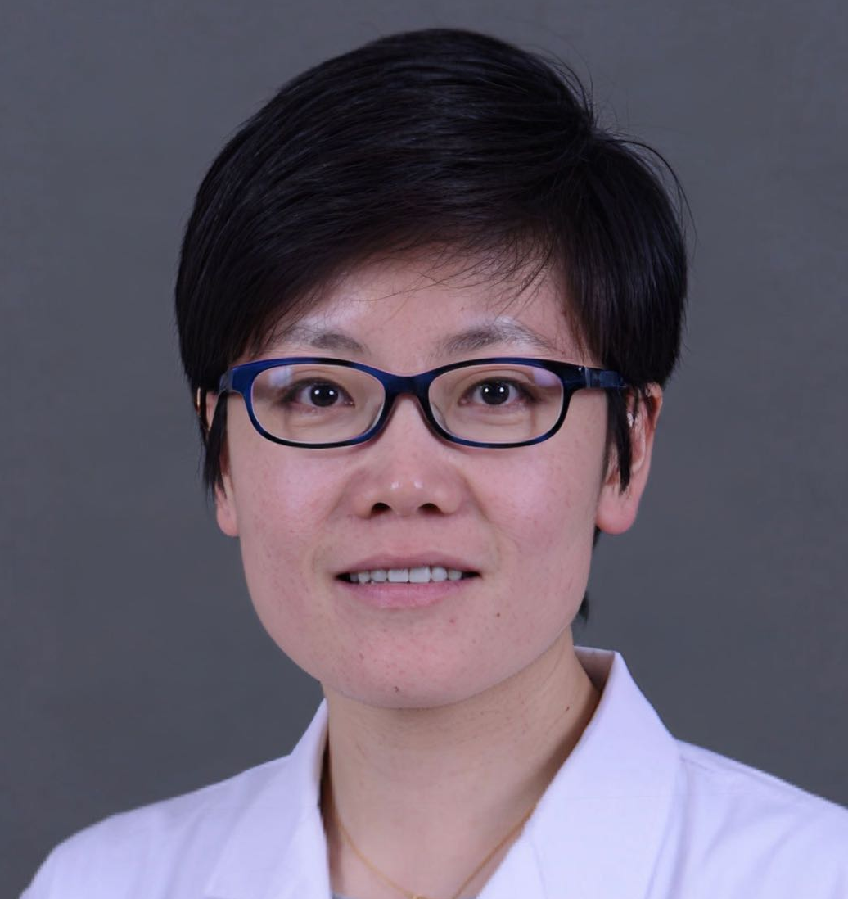


Special thanks to IUS Primer AOCC working group members
Prof. Eun Soo KIM
A/Prof. Ren MAO
Kyungpook National University
First Affiliated Hospital of Sun Yat-sen University
KOREA
CHINA
Prof. Chang Kyun LEE
A/Prof. Jun MIYOSHI
Kyung Hee University
Kyorin University
KOREA
JAPAN
Prof. Yue LI
Dr. Shintaro SAGAMI
Peking Union Medical College Hospital
Kitasato University Kitasato Institute Hospital
CHINA
JAPAN
AOCC: Asian Organization for Crohn's & Colitis; IUS: Intestinal ultrasound; WG: working group.

Slide 4
Learning Objectives
Explore the role of IUS in predicting recurrence, drug responses and post-surgical examinations in IBD.
Understand the role of IUS in managing IBD during pregnancy.
Learn the validation of point-of-care IUS algorithm for ‘treat-to-target’ strategy in IBD.
1
2
3
IBD: inflammatory bowel disease; IUS: Intestinal ultrasound; WG: working group

Slide 5







Overall role of IUS in IBD management
IUS provides answers in real-time allowing early clinical decision-making in routine IBD care
Well-tolerated, fast
Predicting recurrence
Non-invasive
Accurate, reproducible
IBD management
Readily available, no preparation needed
In pregnancy
Predicting therapy response
Performed in real-time at bedside (POCUS)
Cost-effective
Post-surgery assessments
The unique properties of IUS render it a strategic tool in managing IBD.
IBD: inflammatory bowel disease; IUS: intestinal ultrasound; POCUS, point of care ultrasound
Allocca, M., et al. (2021). Journal of Crohn's and Colitis, 15(1), 143-151.

Slide 6
POCUS for expedited diagnosis of IBD in ED – a video case study
POCUS confirmed the diagnosis of ‘new onset IBD’ in a 10-year-old boy presenting with bum pain in ED
Click to Play
Video on insights from Dr Greg Harvey, MD, The Hospital for Sick Children, Toronto (duration: 2.38 min)
Harvey G. [P2SK], Apr 4, 2017. POCUS Leads to Expedited Diagnosis of IBD. YouTube. https://www.youtube.com/watch?v=3CLaMOUlbq4&ab_channel=P2SK
IBD; inflammatory bowel disease; POCUS: point-of-care ultrasound

Slide 7
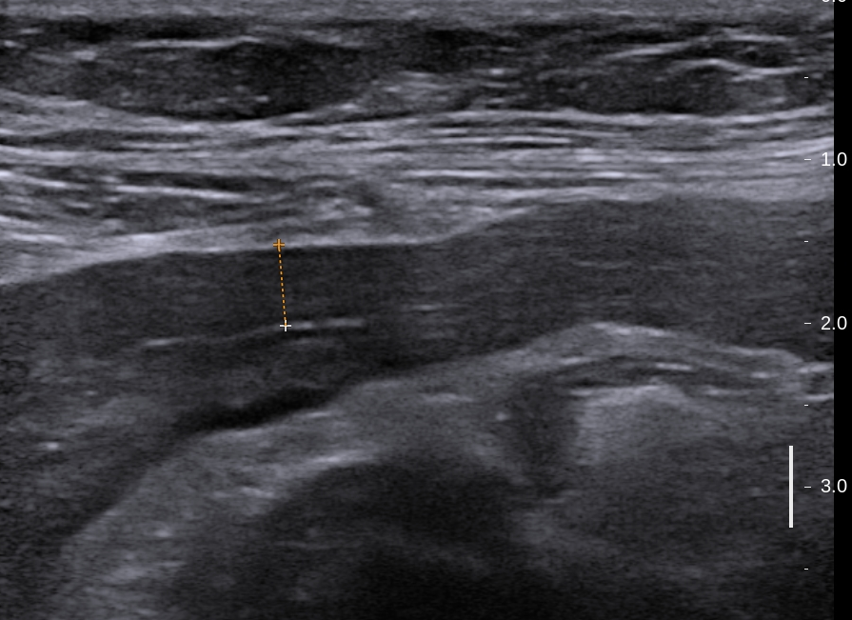
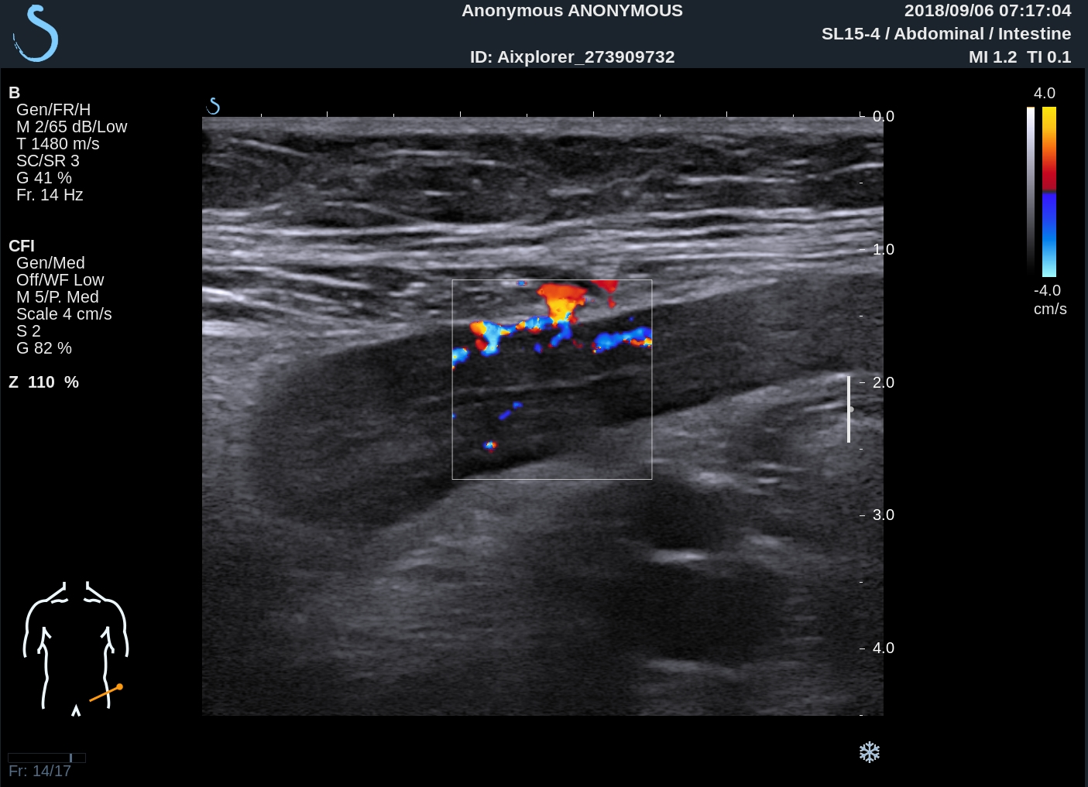

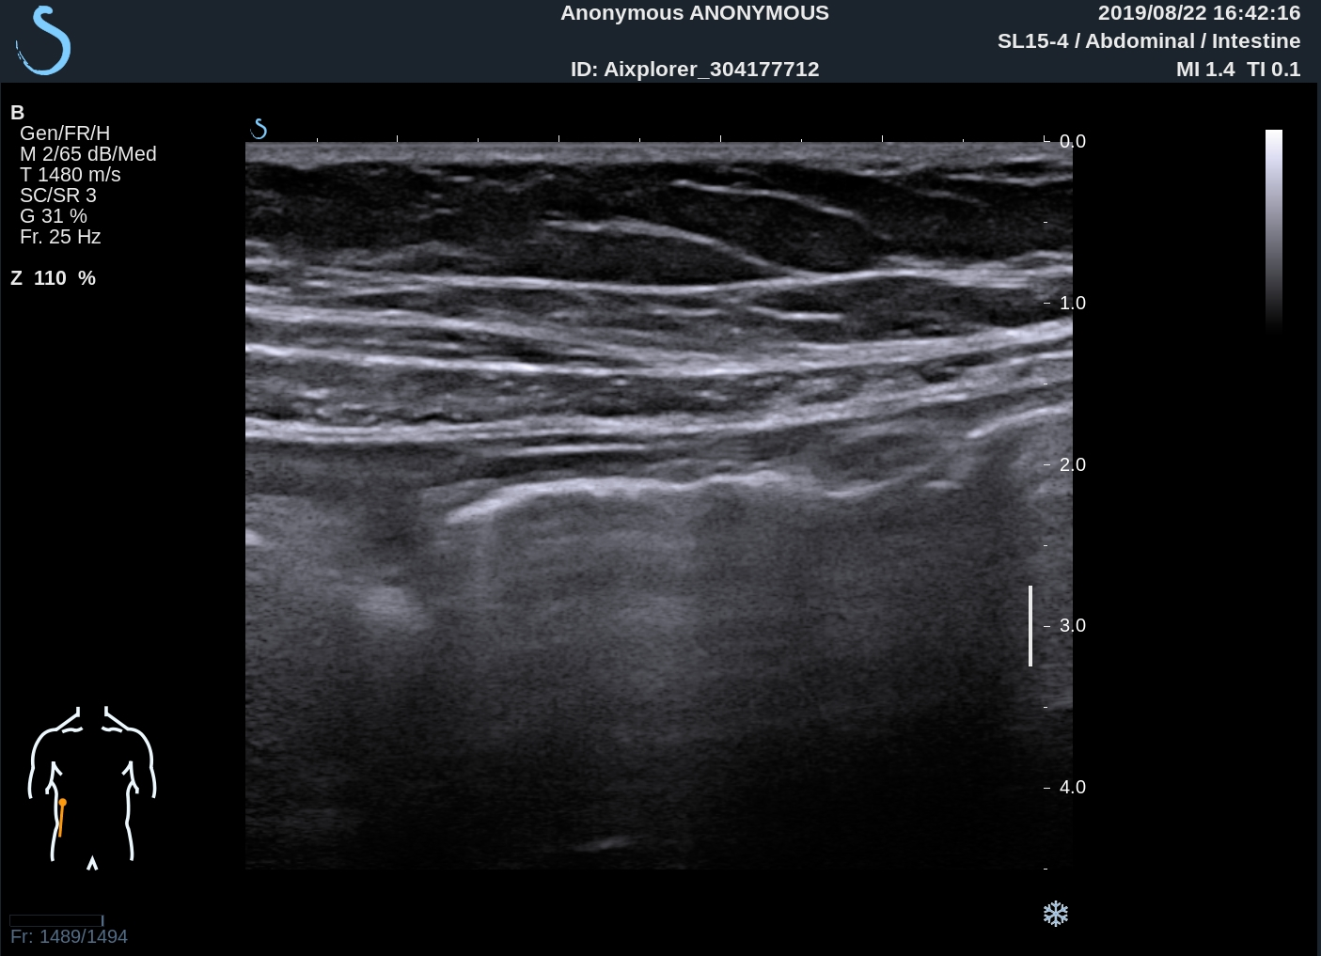
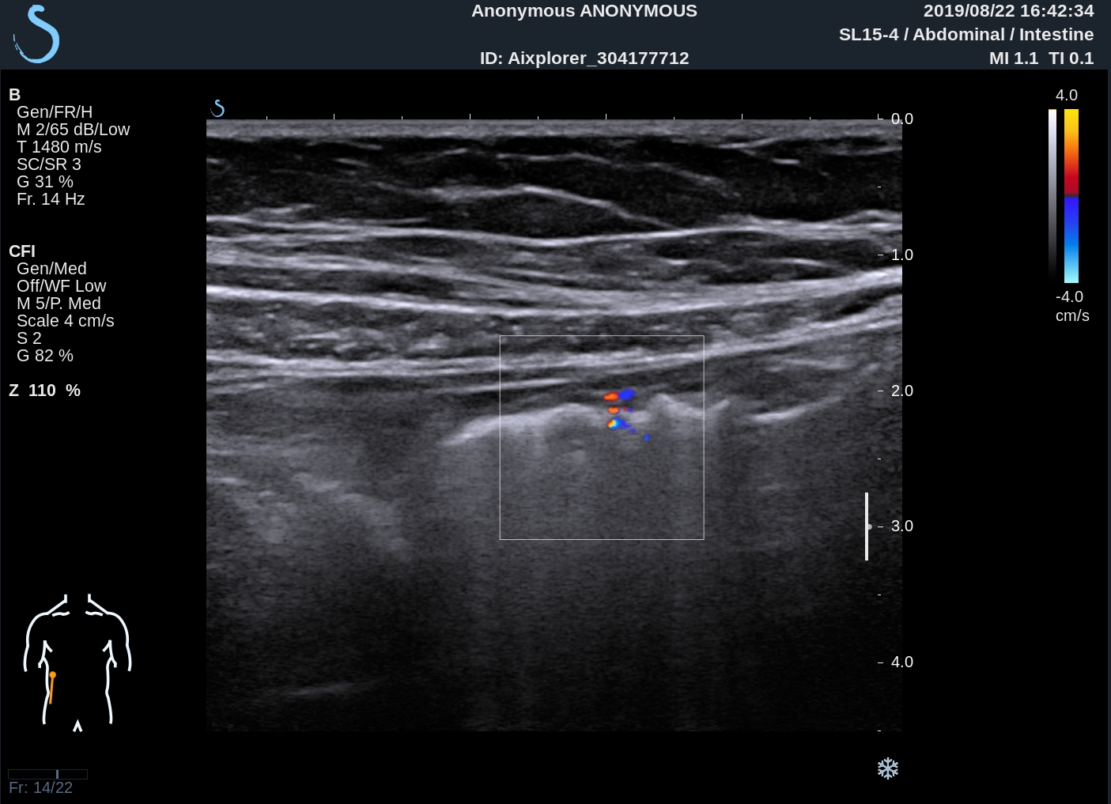
Predicting drug responses
BWT = 5 mm in a patient with UC
Limberg Class III in a patient with UC
BEFORE
TREATMENT
>25% reduction in BWT vs baseline on IUS at week 4 correlates with clinical remission, improvement of biomarkers (CRP and faecal calprotectin) and SES-CD scores at week 16.¹
BWT = 3 mm in in the same patient after treatment
IUS is the most preferred tool for monitoring of IBD by patients: fast, no preparation needed, better doctor-patient interaction.¹
Improved Limberg score in the same patient after treatment
AFTER
TREATMENT
IUS (with or without contrast) can be used for assessing and monitoring inflammatory changes in patients with IBD during treatments.²
All IUS images kindly provided by A/Prof. Ren Mao, First Affiliated Hospital of Sun Yat-sen University, China
CRP: C-reactive protein; BWT: bowel wall thickness; IBD: inflammatory bowel disease; MH: mucosal healing; SES-CD: Simple Endoscopic Score for Crohn’s Disease; TH: transmural healing; UC: ulcerative colitis
1. Allocca, M., et al. (2021). Journal of Crohn's and Colitis, 15(1), 143-151. 2. Calabrese, E., et al. (2016). Inflammatory bowel diseases, 22(5), 1168-1183.
Notes:
SES-CD [Simple Endoscopic Score for Crohn Disease]
1. (allocca
2. Calabrese, E., et al. (2016). Inflammatory bowel diseases, 22(5), 1168-1183.

Slide 8



Post-surgical examinations
Early identification of patients at risk of post-operative recurrence
Prevention of recurrence
Follow-up with IUS: non-invasive alternative to endoscopy
A normal IUS could postpone or avoid ileocolonoscopy
IUS shows 75% diagnostic accuracy and correlated with endoscopic recurrence in postsurgical CD patients.
IUS parameters, particularly loss of wall stratification and vascularization, are superior to clinical and inflammatory parameters in predicting recurrence.
Patients with BWT > 3 mm have doubled risk of surgical recurrence than patients with BWT < 3 mm
IUS is sensitive and specific at detecting postoperative recurrence and correlates well with ileocolonoscopy.
IUS: intestinal ultrasound
Macedo, C. P., et al. (2022). GE-Portuguese Journal of Gastroenterology, 29(3), 178-186.
Notes:
Macedo, C. P., et al. (2022). GE-Portuguese Journal of Gastroenterology, 29(3), 178-186.

Slide 9
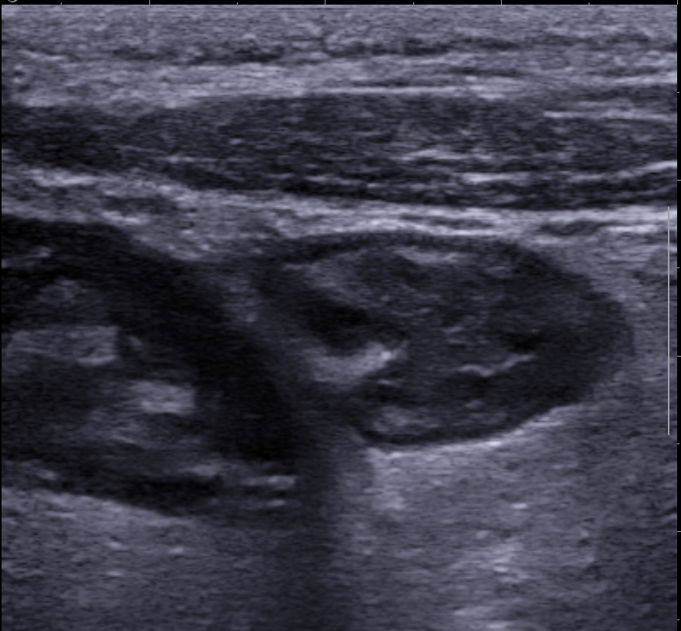
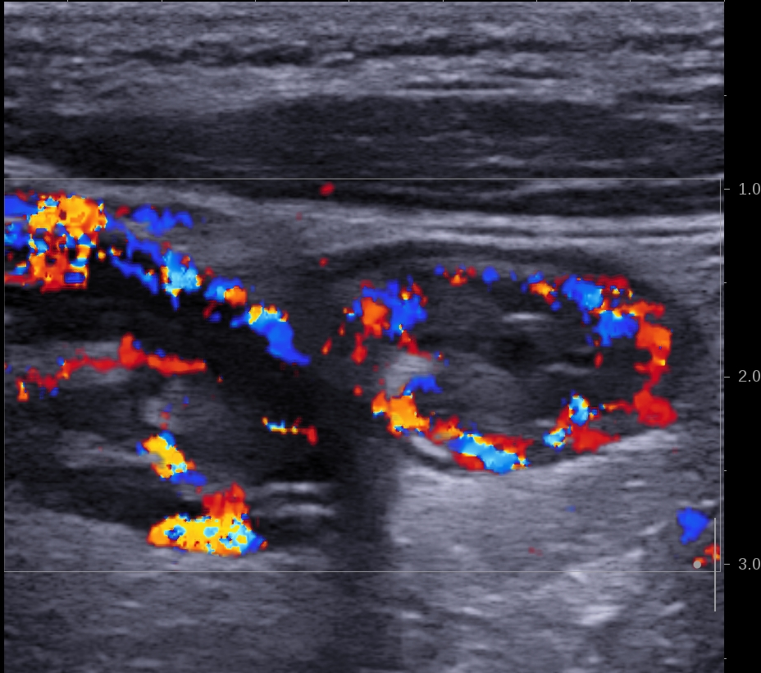

Predicting recurrence
IUS images after right hemicolectomy in a patient with CD
BWT = 6 mm in a patient with UC, IUS showed anastomotic bowel wall thickness and poor peristalsis
TH defined by the normalization of BWT is more accurate than MH alone for predicting the risk of recurrence.¹
Limberg score = Class III
TH on IUS predicts a lower risk of clinical relapse, hospitalization, & surgery in the following year vs MH alone.¹
Unchanged or worsened BWT after 6 months from surgery or the post-operative persistence of BWT >6 mm, predicts a high risk of clinical and surgical recurrence.²
Patients with BWT > 3 mm have doubled risk of surgical recurrence than patients with BWT < 3 mm.²
Absolute incidence of new surgical interventions positively correlates with increased BWT. ²
All IUS images kindly provided by A/Prof. Ren Mao, First Affiliated Hospital of Sun Yat-sen University, China
IUS is a patient-friendly modality for monitoring and prognosticating CD.²
BWT: bowel wall thickness; CD: Crohn’s disease; MH: mucosal healing; TH: transmural healing; IUS: intestinal ultrasound
1. Allocca, M., et al. (2021). Journal of Crohn's and Colitis, 15(1), 143-151.;2. Fraquelli, M., et al. (2020). Digestive and Liver Disease, 52(1), 9-18.
Notes:
1 alloca
2 Fraquelli, M., et al. (2020). Digestive and Liver Disease, 52(1), 9-18.

Slide 10


Role of IUS in managing IBD during pregnancy
IUS is the safest imaging technique for use in pregnancy.¹
Endoscopy and CT present risks to the fetus.¹
Pregnancy can affect the interpretation of traditional symptoms and biomarkers.¹
Radiation-free
Non-invasive
IUS is more accurate than calprotectin in pregnancy.¹
High specificity helps to distinguish pregnancy-related GI symptoms that are not related to active IBD.¹
IUS provides information on disease activity, extent and treatment response even during 2nd and 3rd trimester.²
CT: computed tomography; IBD: inflammatory bowel disease; IUS: intestinal ultrasound
1 Flanagan, E., et al. (2020). Journal of Crohn's and Colitis, 14(10), 1405-1412. 2. De Voogd, F., et al. (2022). Inflammatory Bowel Diseases, 28(7), 1045-1052.
Notes:
1 Flanagan, E., et al. (2020). Journal of Crohn's and Colitis, 14(10), 1405-1412.
2. De Voogd, F., et al. (2022). Inflammatory Bowel Diseases, 28(7), 1045-1052.
3. Maaser, C., et al. (2019) Journal of Crohn's and Colitis, 13(2), 144-164K.

Slide 11
IUS for managing IBD during pregnancy
IUS images of a young pregnant lady with UC
In severe UC, there may be increased echogenicity of the surrounding fat, as shown with green * in the below image on the right.
This fat is rather well-compressible and should be considered as oedema associated with secondary hyperemia and is not a sign of true transmural inflammation.
Image credit: Zijta, F., Vanhooymissen I & Puylaert J, Radiology Assistant website. Reproduced with permission from the Radiology Assistant website, strictly for educational purposes only.
IUS: intestinal ultrasound; UC: ulcerative colitis
Zijta, F., Vanhooymissen, I. & Puylaert, J. Crohn's disease - role of Ultrasound. Radiology Assistant. Available at: https://radiologyassistant.nl/abdomen/bowel/ultrasound-in-crohns-disease
Notes:
SES-CD [Simple Endoscopic Score for Crohn Disease]
1. (allocca
2. Calabrese, E., et al. (2016). Inflammatory bowel diseases, 22(5), 1168-1183.

Slide 12
Point of care IUS algorithm for “treat-to-target” strategy
Point of care IUS algorithm for ‘treat-to-target’ strategy
Treat to target:
Complete and objective control of inflammation for superior long-term outcomes
Requires close monitoring with non-invasive, accurate, reliable and cheap modality
Patients prefer IUS over other modalities like endoscopy, MRI, CT
CD
UC
Symptoms and/ or elevated biomarkers
Clinical and biochemical remission
Symptoms and/
or elevated biomarkers
Consider IUS at regular intervals to detect pre-clinical relapse (e.g. 1 year)
IUS not necessary
Perform IUS
Clear activity in CD
No findings, doubt or IUS suboptimal
Clear activity in UC
Consider small bowel disease and proctitis in CD
Consider proctitis in UC
Reliable assessment of
complications
Extensive complications or symptomatic stricture
Consider endoscopy/ imaging
Treatment decision based on IUS
Assess treatment response after 3 months in CD and 8 weeks in UC
CD: Crohn’s disease; CT: computed tomography; IUS: intestinal ultrasound; MRI: magnetic resonance imaging; UC: ulcerative colitis
Bots, S., et al. (2022). Journal of Crohn's and Colitis, 16(4), 606-615.
Notes:
Bots, S., et al. (2022). Journal of Crohn's and Colitis, 16(4), 606-615.

